Slide 1
Topic: Linear Algebra EQ: Do perpendicular lines have specific properties associated with their gradients.?

Slide 2
Contents
Glossary or Formula Page
Page
Date
Description
2
3

Slide 3
Tasks
24
7
30
Essential Question
Questions
Notes
Summary
4
5

Slide 4
24
7
30
Date
Linear Algebra
EQ: Do perpendicular lines have specific properties associated with their gradients.?
What are Perpendicular line?
5

Slide 5
24
7
30
Date
Linear Algebra
EQ: Do perpendicular lines have specific properties associated with their gradients.?
What are Perpendicular line?
Lines that are perpendicular intersect at right angles.
5

Slide 6
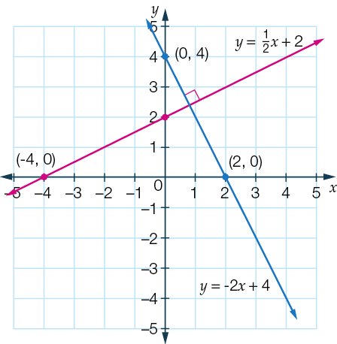
24
7
30
Date
Linear Algebra
EQ: Do perpendicular lines have specific properties associated with their gradients.?
What are Perpendicular line?
Lines that are perpendicular intersect at right angles.
5

Slide 7
24
7
30
Date
Linear Algebra
EQ: Do perpendicular lines have specific properties associated with their gradients.?
What are Perpendicular line?
Lines that are perpendicular intersect at right angles.
The blue line y = -2x + 4 has an x-intercept of (2, 0) and a y-intercept of (0, 4).
5

Slide 8
24
7
30
Date
Linear Algebra
EQ: Do perpendicular lines have specific properties associated with their gradients.?
What are Perpendicular line?
Lines that are perpendicular intersect at right angles.
The blue line y = -2x + 4 has an x-intercept of (2, 0) and a y-intercept of (0, 4).
If these points are rotated 90° anticlockwise about the origin they will be positioned at (0, 2) and (-4, 0).
5

Slide 9
24
7
30
Date
Linear Algebra
EQ: Do perpendicular lines have specific properties associated with their gradients.?
What are Perpendicular line?
Lines that are perpendicular intersect at right angles.
The blue line y = -2x + 4 has an x-intercept of (2, 0) and a y-intercept of (0, 4).
If these points are rotated 90° anticlockwise about the origin they will be positioned at (0, 2) and (-4, 0).
Joining these points gives us a line perpendicular to y = -2x + 4. (The red line)
5

Slide 10
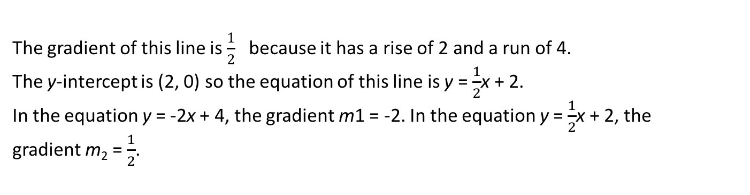
24
7
30
Date
Linear Algebra
EQ: Do perpendicular lines have specific properties associated with their gradients.?
What are Perpendicular line?
Lines that are perpendicular intersect at right angles.
The blue line y = -2x + 4 has an x-intercept of (2, 0) and a y-intercept of (0, 4).
If these points are rotated 90° anticlockwise about the origin they will be positioned at (0, 2) and (-4, 0).
Joining these points gives us a line perpendicular to y = -2x + 4. (The red line)
The gradient of this line is $\frac{1}{2}$ because it has a rise of 2 and a run of 4.
The y-intercept is (2, 0) so the equation of this line is y = $\frac{1}{2}$x + 2.
In the equation y = -2x + 4, the gradient m1 = -2. In the equation y = $\frac{1}{2}$x + 2, the gradient m₂ = $\frac{1}{2}$.
5

Slide 11
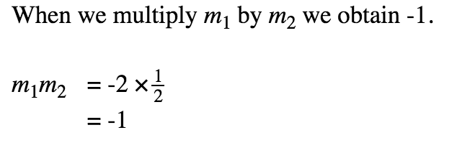
24
7
30
Date
Linear Algebra
EQ: Do perpendicular lines have specific properties associated with their gradients.?
5

Slide 12
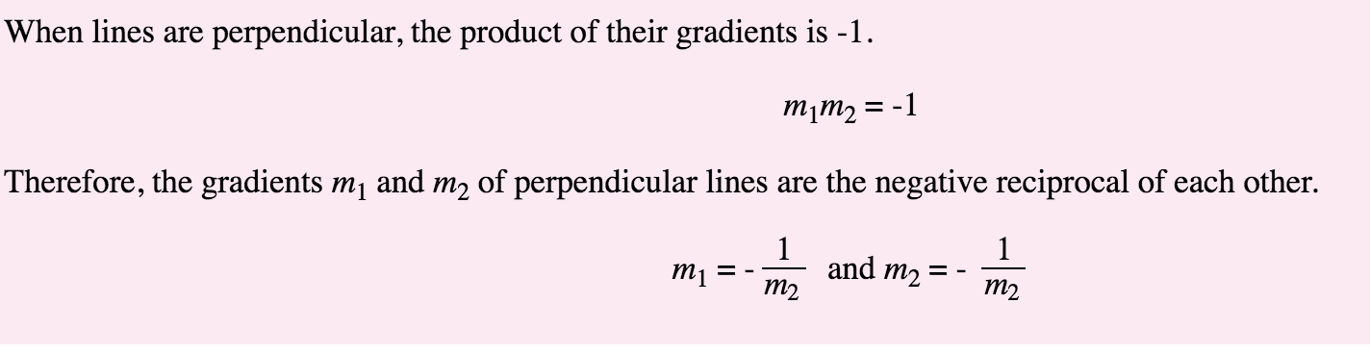
24
7
30
Date
Linear Algebra
EQ: Do perpendicular lines have specific properties associated with their gradients.?
5

Slide 13
24
7
30
Date
Linear Algebra
EQ: Do perpendicular lines have specific properties associated with their gradients.?
Example #2
Show that the line with equation y = 3x − 10 is perpendicular to the line with equation 6y + 2x + 12 = 0.
5

Slide 14
24
7
30
Date
Linear Algebra
EQ: Do perpendicular lines have specific properties associated with their gradients.?
Example #2
Show that the line with equation y = 3x − 10 is perpendicular to the line with equation 6y + 2x + 12 = 0.
Step 1 Rearrange the equations using inverse operations so that both are in the form y = mx + b.
5

Slide 15
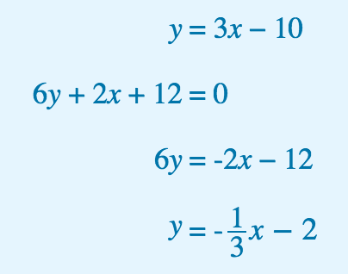
24
7
30
Date
Linear Algebra
EQ: Do perpendicular lines have specific properties associated with their gradients.?
Example #2
Show that the line with equation y = 3x − 10 is perpendicular to the line with equation 6y + 2x + 12 = 0.
Step 1 Rearrange the equations using inverse operations so that both are in the form y = mx + b.
5

Slide 16
24
7
30
Date
Linear Algebra
EQ: Do perpendicular lines have specific properties associated with their gradients.?
Example #2
Show that the line with equation y = 3x − 10 is perpendicular to the line with equation 6y + 2x + 12 = 0.
Step 1 Rearrange the equations using inverse operations so that both are in the form y = mx + b.
Step 2 Identify the gradients m1 and m2, and multiply to determine whether m1 × m2 = -1.
5

Slide 17
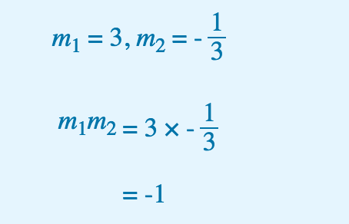
24
7
30
Date
Linear Algebra
EQ: Do perpendicular lines have specific properties associated with their gradients.?
Example #2
Show that the line with equation y = 3x − 10 is perpendicular to the line with equation 6y + 2x + 12 = 0.
Step 1 Rearrange the equations using inverse operations so that both are in the form y = mx + b.
Step 2 Identify the gradients m1 and m2, and multiply to determine whether m1 × m2 = -1.
5

Slide 18

24
7
30
Date
Linear Algebra
EQ: Do perpendicular lines have specific properties associated with their gradients.?
Example #2
Show that the line with equation y = 3x − 10 is perpendicular to the line with equation 6y + 2x + 12 = 0.
Step 1 Rearrange the equations using inverse operations so that both are in the form y = mx + b.
Step 2 Identify the gradients m1 and m2, and multiply to determine whether m1 × m2 = -1.
5

Slide 19
Notes Review
24, 7 ,30
Date
Title
Essential question
Notes complete
Notes complete with colour and diagrams
Questions completed
Contents page filed in
Formula page filled in

Slide 20
Homework
Review your notes and write a summary answering the essential question.

